Slide 1
Sales Performance, Pricing & Promotion Analysis
Boitumelo Tsotetsi

Slide 2
CONTENTS
Business Objectives
Executive KPI Summary
Sales Trend
Normal Price vs Promotional Price
Business Insights
Business Recommendations
Conclusion

Slide 3
objective
The objective of this analysis is to evaluate the product's sales performance, pricing, profitability and response to promotional pricing.

Slide 4
EXECUTIVE KPI summary

Slide 5
Key metrics
Total Sales | R186,909,828.12
Total Cost of Sales | R194,026,109.57
Total Quantity Sold | 5,279,872 units
Total Gross Profit | -R7,116,281.45
Overall Gross Profit % | -3.81%
Weighted Average Unit Selling Price | R35.40
Overall Gross Profit per Unit | -R1.35
Loss-Making Days | 607 out of 1,053 days
Loss-Making Days % | 57.65%

Slide 6
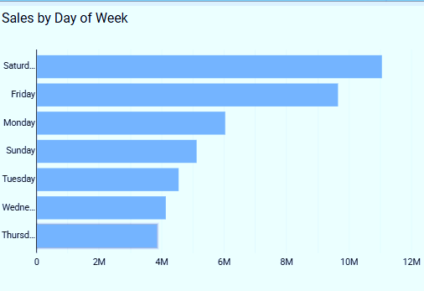
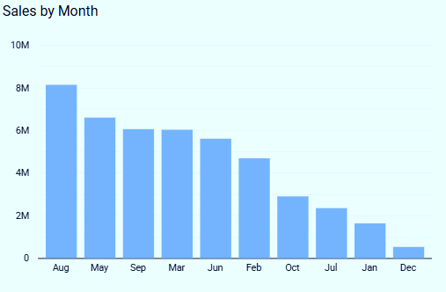
Sales Trend

Slide 7
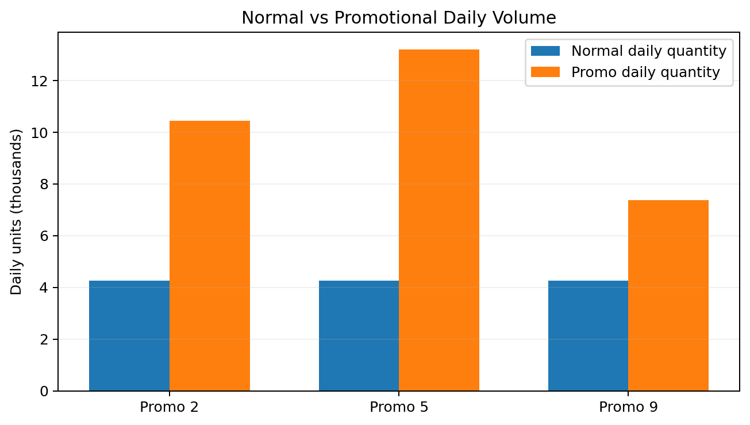
NORMAL PRICE VS PROMOTIONAL PRICE
Promo 2
10,440 units/day
Elasticity -6.17 • GP% -3.0%
Promo 5
13,210 units/day
Elasticity -7.98 • GP% -7.3%
Promo 9
7,376 units/day
Elasticity -4.19 • GP% -2.1%

Slide 8
Business Recommendations
Optimise Promotional Discounts
Review Pricing Strategy
Establish a minimum selling price that protects gross profit per unit.
Monitor:
Unit cost
Selling price
Gross profit per unit
Gross profit %
Because demand is highly elastic, smaller price reductions may potentially generate meaningful volume increases without sacrificing as much margin.
Test different discount levels and compare:
Discount → Volume → Revenue → Gross Profit​

Slide 9
Business insights
Strong Price Sensitivity
Promotions Increase Volume
Promotional periods show highly elastic demand, with elasticity values ranging from -4.19 to -7.98.
Average daily promotional quantity was approximately 9,970 units, compared with 4,260 units during normal pricing.
Promotions Increase Revenue
Loss-Making Days Are Significant
Average daily sales increased from approximately:
R155,839 → R319,947 during promotional periods.
57.65% of all observed days were loss-making..

Slide 10
SUMMARY
The analysis shows that the product has highly price-sensitive demand. Promotional pricing resulted in significantly higher quantities sold and higher daily sales.
However, the analysis also shows that higher volume does not necessarily translate into stronger profitability.

Slide 11
THANK YOU
Boitumelo Tsotetsi
tsotetsiboitumelo1@gmail.com
Student Nr: 2805002206

